Slide 1
Candy Power Ranking
Farzad Radmehr

Slide 2
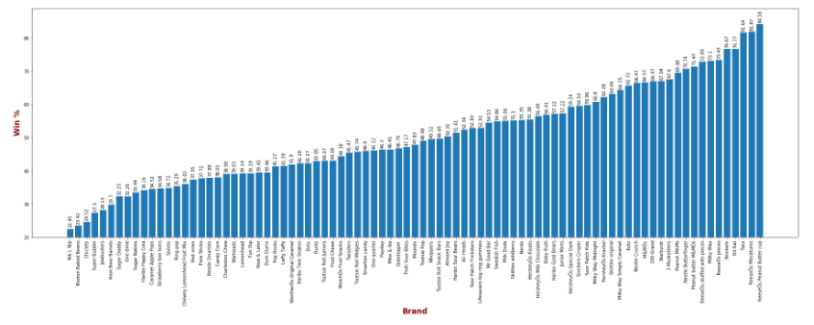
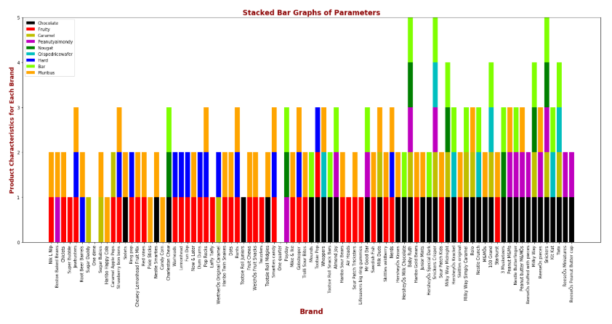
1) Looking at the Least to the Most Successful Brands

Slide 3
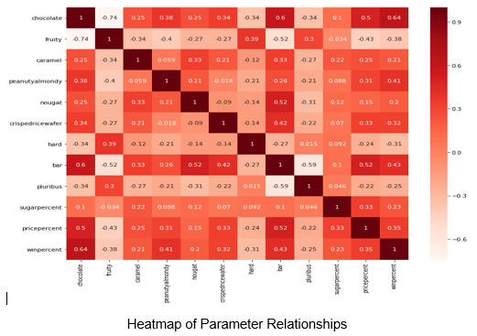
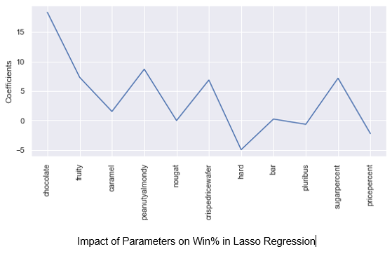
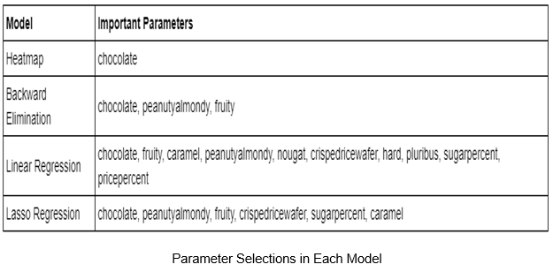
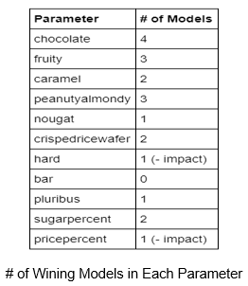
2) Modeling-Parameter Selection
Recommendation
Below product characteristics drive more customers:
Chocolate
Peanutyalmondy
Fruity
Crispedricewafer
Caramel
Add one or more of the above gradients to increase Sugar % and decrease Price %.

